Slide 1
Rising Junior Summer Assignment/Photography
Ms. McLaughlin
bmclaughlin2@schools.nyc.gov
First Grade MP1 September 2024
Add photographs to google slide/add writing to google doc and all work should be submitted here:
https://drive.google.com/drive/folders/1E_uQiD1pfp5Gd1YQ-okaiSzbiSogh3hi

Slide 2
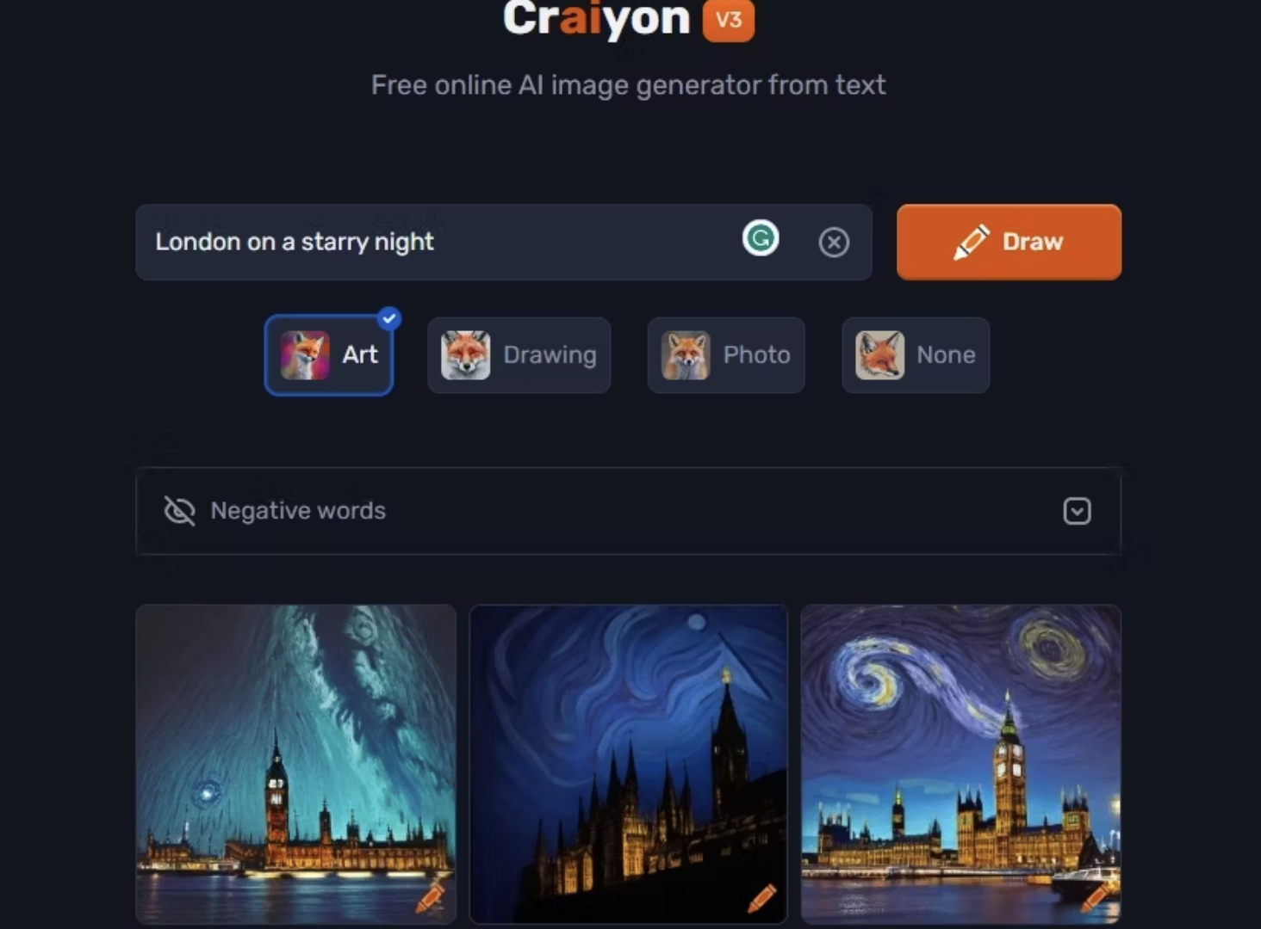
How is AI affecting society?
PROS:
https://medium.com/design-ibm/the-role-of-art-in-ai-31033ad7c54e
CONS:
https://www.liberties.eu/en/stories/disadvantages-of-artificial-intelligence/44289
Write a paragraph statement on where you stand with AI. Have you incorporated it into your art practice? Writing practice? Why or why not? What negatives and positives does AI have on our art practice, writing practice and society as a whole?

Slide 3
Summer Assignment:
Using your photography archive, choose up to TEN IMAGES to recreate an AI project with:
AI takes writing and translates this into visual art
Choose a free APP and create TEN IMAGES using prompts that describe your current photography style
  See free AI generator APPs here: https://www.makeuseof.com/ai-text-to-art-generators/
Bring in 10 AI images and your writing for your SUMMER ASSIGNMENT due September 9th 2024

Slide 4
ADDITIONAL SUMMER READING
Choose two articles and respond to each in 3-5 full sentences in your photography notebook (to be collected in September):
Aperture Magazine is a photography industry staple and incredible magazine:
https://aperture.org/
RangeFinder is an industry magazine for the latest news in the photography industry. The articles to choose from this list should be related to TECHNICAL ideas in photography.
https://www.rangefinderonline.com/
Choose two articles.
DUE first week in September:
10 total images
Upload to drive or save on Flashdrive

Slide 5
College Essay Practice:
Photography and Related Media AAS Essays
Please respond thoughtfully.
1. In a maximum of 500 words, identify two photographers or artists who have influenced your photography. Cite specific examples of how this influence has shaped your work.
This is an opportunity to show your curiosity about the world of art and photography so think twice about writing about your high school art teacher, the latest Instagram star, or a photographer who is featured on a reality TV show. Make clear connections between your work and the work of the people who influenced you.
2. In a maximum of 500 words, write about your experience learning photography up until now.
Did you take classes in high school or college? Did you take photography workshops? Are you self-taught?

Slide 6
Requirements for College Letter of Recommendation:
85 or higher in Photography class
Email resume to Ms. McLaughlin: Bmclaughlin2@schools.nyc.gov
Identify 3-5 colleges you wish to apply for

