Slide 1
Rising Senior AP Prep/Photography
Ms. McLaughlin
bmclaughlin2@schools.nyc.gov
First Grade MP1 September 2025
Add photographs to google slide/add writing to google doc and all work should be submitted here:

Slide 2
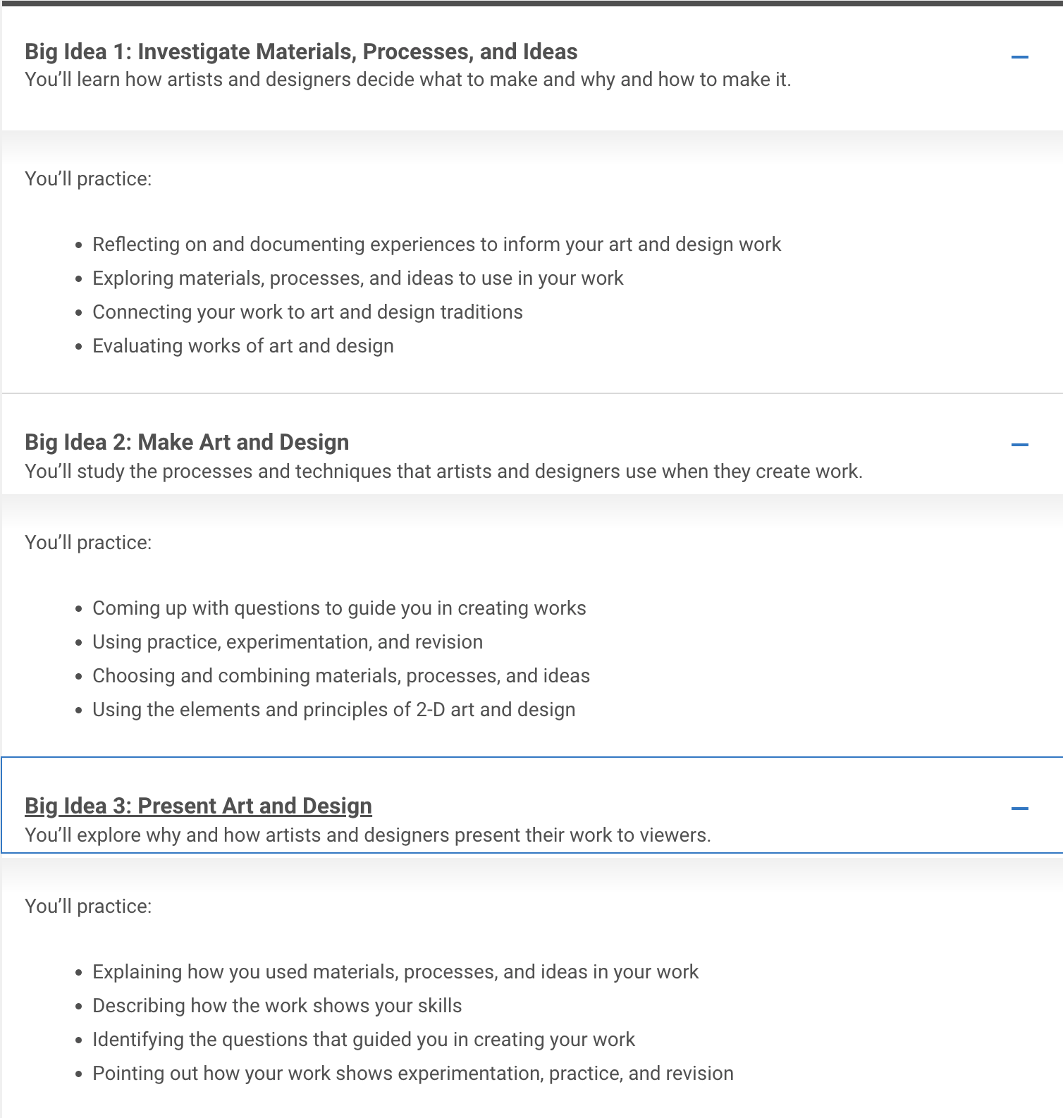
What is AP?
AP stands for Advanced Placement:
https://apstudents.collegeboard.org/courses/ap-2-d-art-and-design
The Senior Year Photography class will be researching AP Portfolio project ideas, beginning in December 2024, producing the AP Portfolio project, revising and submitting AP Portfolios in May 2026 to earn college credit. The summer assignment is to help you think through project ideas for next school year! See examples of the AP Portfolio in the link above.

Slide 3
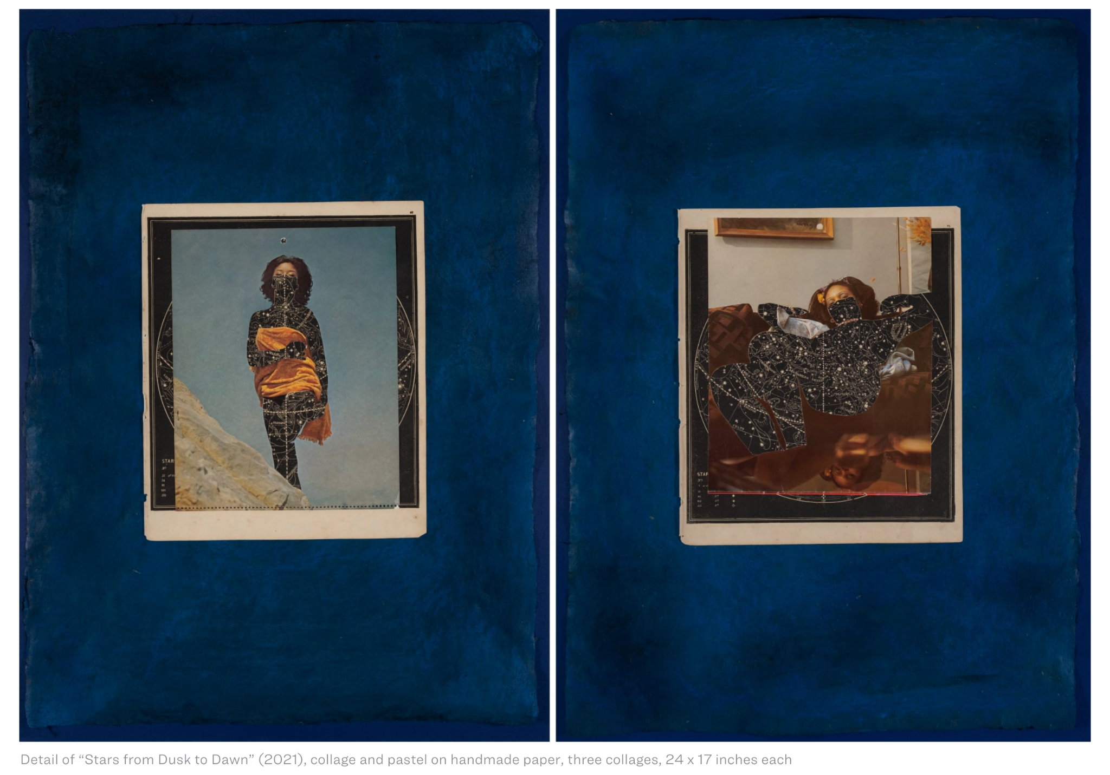
There are so many different approaches can may take for the AP Photography Portfolio:
View the discussion with A+D alumni Lorna Simpson on combining photography and collage:
https://www.thisiscolossal.com/interviews/lorna-simpson/

Slide 4
AP Assignment:
SELF DESIGNED PROJECT IDEAS
Write out 3-5 project ideas for the SUSTAINED INVESTIGATION
Choose 2-3 ideas you may focus on for your SUSTAINED INVESTIGATION and begin photographing examples
Bring in 10-15 rough draft images/5 images per idea for your SUMMER ASSIGNMENT due September 2025

Slide 5
What’s the BIG IDEA? Narrowing this down can be challenging…
A DOUBLE EXPOSURE project could mean>>>>
A COLLAGE AND STYLING project could mean>>>>
A PROJECT USING SILK AND THE CITY project could mean>>>>
A PROJECT USING YARN project could mean>>>>
WHAT IS YOUR BIG IDEA FOR YOUR SUSTAINED INVESTIGATION/AP PORTFOLIO (ONE IDEA)?

Slide 6
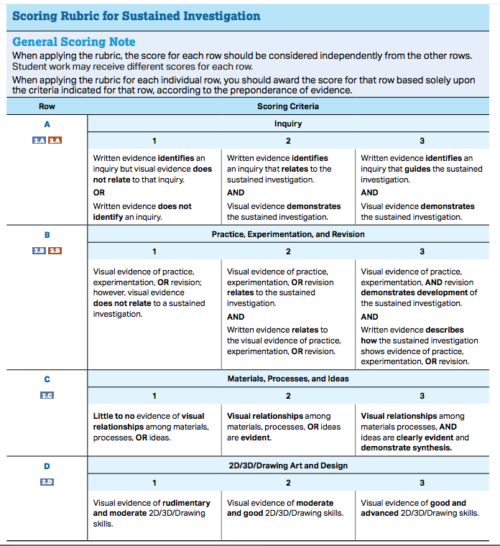
Rubric Guide for AP Portfolio
The AP Portfolio guidelines:
Are we connecting with expectations for a sustained investigation?
We will be meeting in groups throughout this process to help connect our visual projects, our process and our writing to earn the highest score possible.

Slide 7
College Essay Practice:
Photography and Related Media AAS Essays
Please respond thoughtfully.
1. In a maximum of 500 words, identify two photographers or artists who have influenced your photography. Cite specific examples of how this influence has shaped your work.
This is an opportunity to show your curiosity about the world of art and photography so think twice about writing about your high school art teacher, the latest Instagram star, or a photographer who is featured on a reality TV show. Make clear connections between your work and the work of the people who influenced you.
2. In a maximum of 500 words, write about your experience learning photography up until now.
Did you take classes in high school or college? Did you take photography workshops? Are you self-taught?

Slide 8
Requirements for College Letter of Recommendation:
85 or higher in Photography class
Identify 3-5 colleges you wish to apply for
Email resume to Ms. McLaughlin: Bmclaughlin2@schools.nyc.gov

