Slide 1
MEET THE ARTIST:
ASSIGNMENT 01: DISCOVERY
ASSIGNMENT 02: MOODBOARD
ASSIGNMENT 03: STYLE FRAME
ASSIGNMENT 04: 1 FINALIZED ASSET
SYMBOLIC SELF PORTRAIT:
ASSIGNMENT 05: THUMBNAILS
ASSIGNMENT 06: ROUGH DRAFT
ASSIGNMENT 07: FINAL DRAFT
*PORTFOLIO: If you are going to art school make a minimum of 4 pieces for the schools you plan on attending
here are Portfolio Prompts and resources if you are stuck

Slide 2


MEET THE ARTIST HAND IN LIST
Summer Assignment Meet the Artist
Personality test/Planning worksheet
Mood boards
Style Frame
Asset
(Optional) Music, Storyboards, More Assets
MEET THE ARTIST // CREATIVE EXPLORATION
Slide 1 of 12

Slide 3
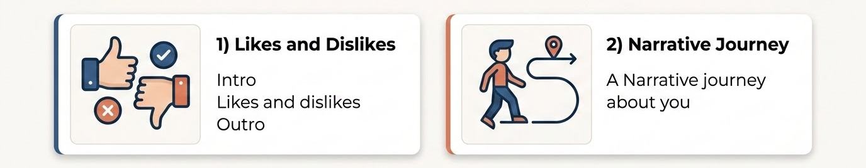
Meet the Artist
(or Meet the Cook / Hero / Scientist etc…)
Meet the Artist is an animated creative self portrait that we often show at the Animation Show
You can approach this project in 2 different ways or a blend of the 2.
1)Likes and dislikes: Intro likes and dislikes Outro
2)Narrative Journey: A Narrative journey about you
Examples on the next slides
examples next slides

Slide 4
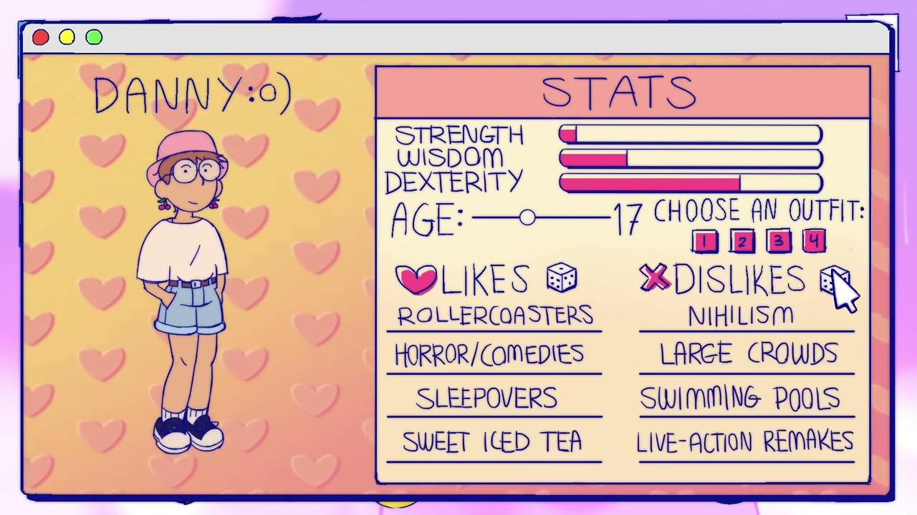
LIKES AND DISLIKES

Slide 5
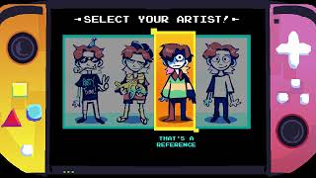
NARRATIVE JOURNEY

Slide 6

MTA ARCHIVE
press here

Slide 7
Assignment 1: Self Discovery & Brainstorming
Before you make anything let's do some self discovery & Brainstorming!
1)Take this personality test!
a.Who are you like?
2)Fill out this Worksheet

Slide 8
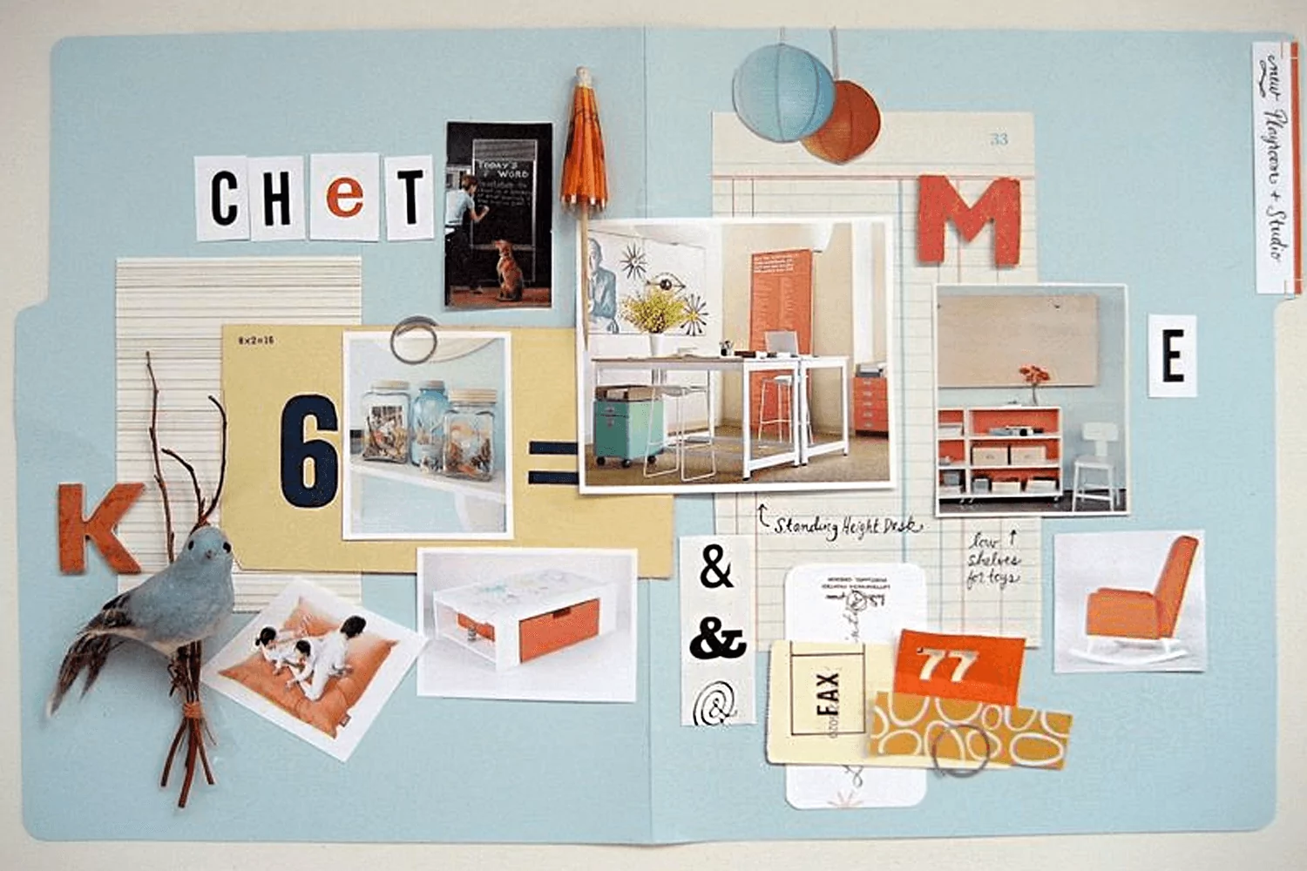

Assignment 2: Mood Boarding
Create 1-3 mood boards that illustrate your vibe/aesthetic inspiration
A Strong Moodboard:Consistency Over Randomness
A great mood board is not just random Pinterest scrolling. It is an intentional edit. Look for repetition across these core design elements:
Colors Repeat: Limit your aesthetic space to 3-4 dominant colors.
Shapes Repeat: Consistently sharp/geometric or soft/organic forms.
Themes Repeat: A common underlying motif unites the visuals.
Fonts Match: The type fits the era and tone of your subject.
Collect visual references to map out and ground your visual identity.
Color Palettes
Illustration Styles
Typography
Motion References
Photography
Character Art
HOW SHOULD THIS FEEL?
Cozy? Energetic? Mysterious? Funny? Retro? Professional?

Slide 9
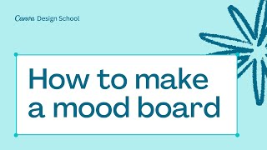

Slide 10
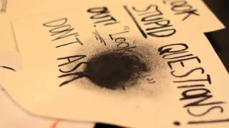
Assignment 3: Style Frame
Create at least one Style frame. A Finished Final product frame that defines the entire aesthetic of your animation create it at:
3840 × 2160 px as PSD and High quality jpeg
if traditional 11” x6.2”
What is a Style Frame?
"One finished, production-ready screenshot from a creative project that doesn't exist yet."
It solves design problems early by answering:
What does it look like finished? Art style and composition.
What colors are used? Unified applied palette.
What type is utilized? Live headline styling.
What is the mood? The final atmospheric depth.

Slide 11
Some animations with “Sweet” styleframes!
http://motionographer.com/quickie/casse-cro-te/
https://vimeo.com/13463054
https://vimeo.com/12262466

Slide 12
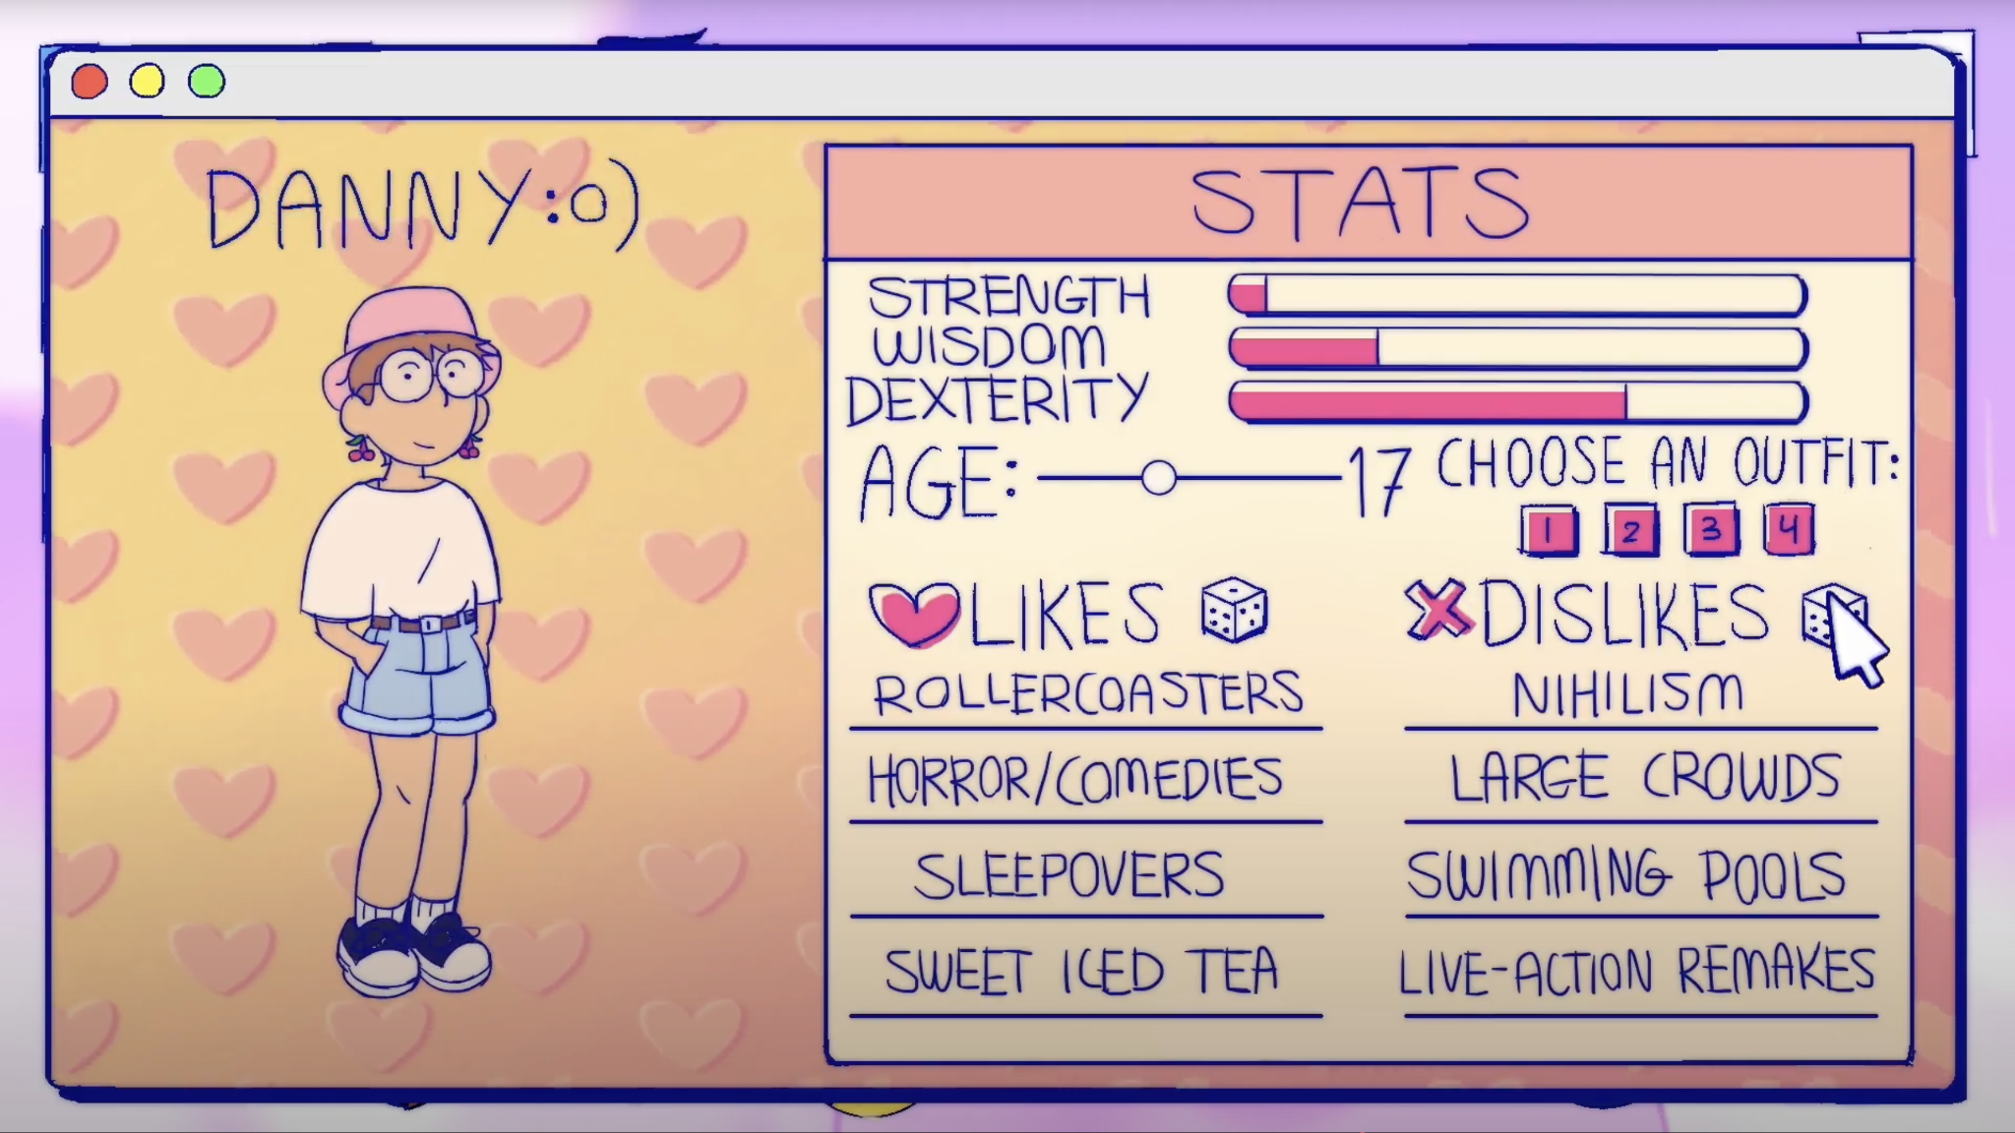
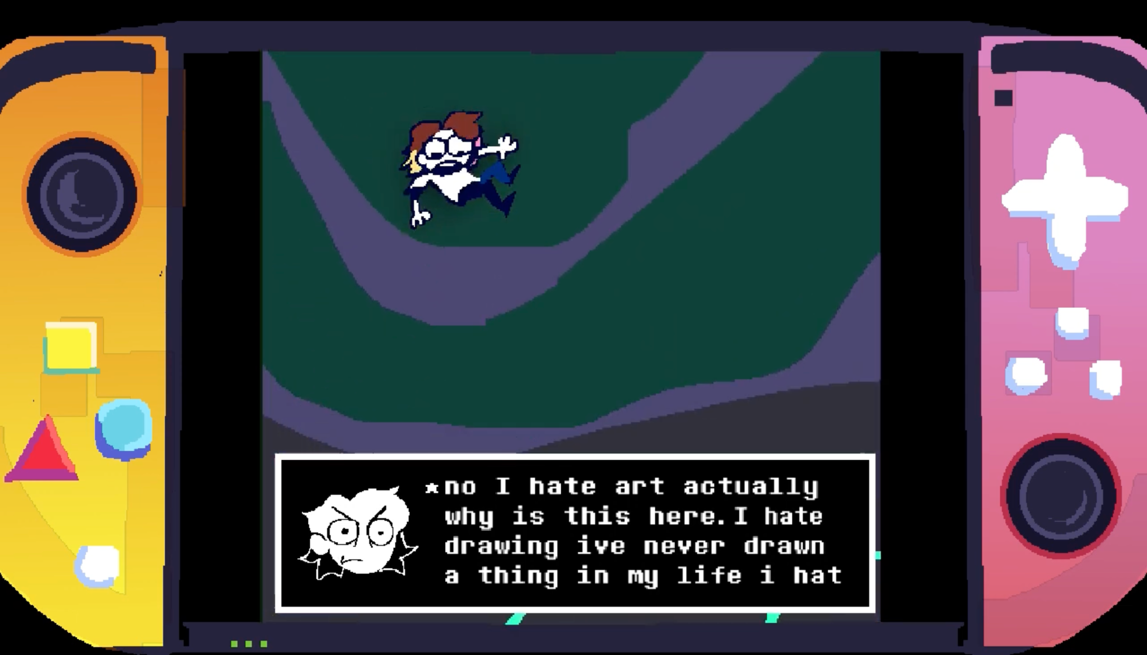
Assignment 4: Asset with layers
Create at least one Final Asset for your Meet the artist in layers
@ 3840 × 2160 px as a PSD and High quality jpeg
if traditional 11” x6.2”
1) If you are doing a likes and dislikes you can do a bio ex.
2)If you are doing narrative journey you can do a final shot from your story with proper layers

Slide 13

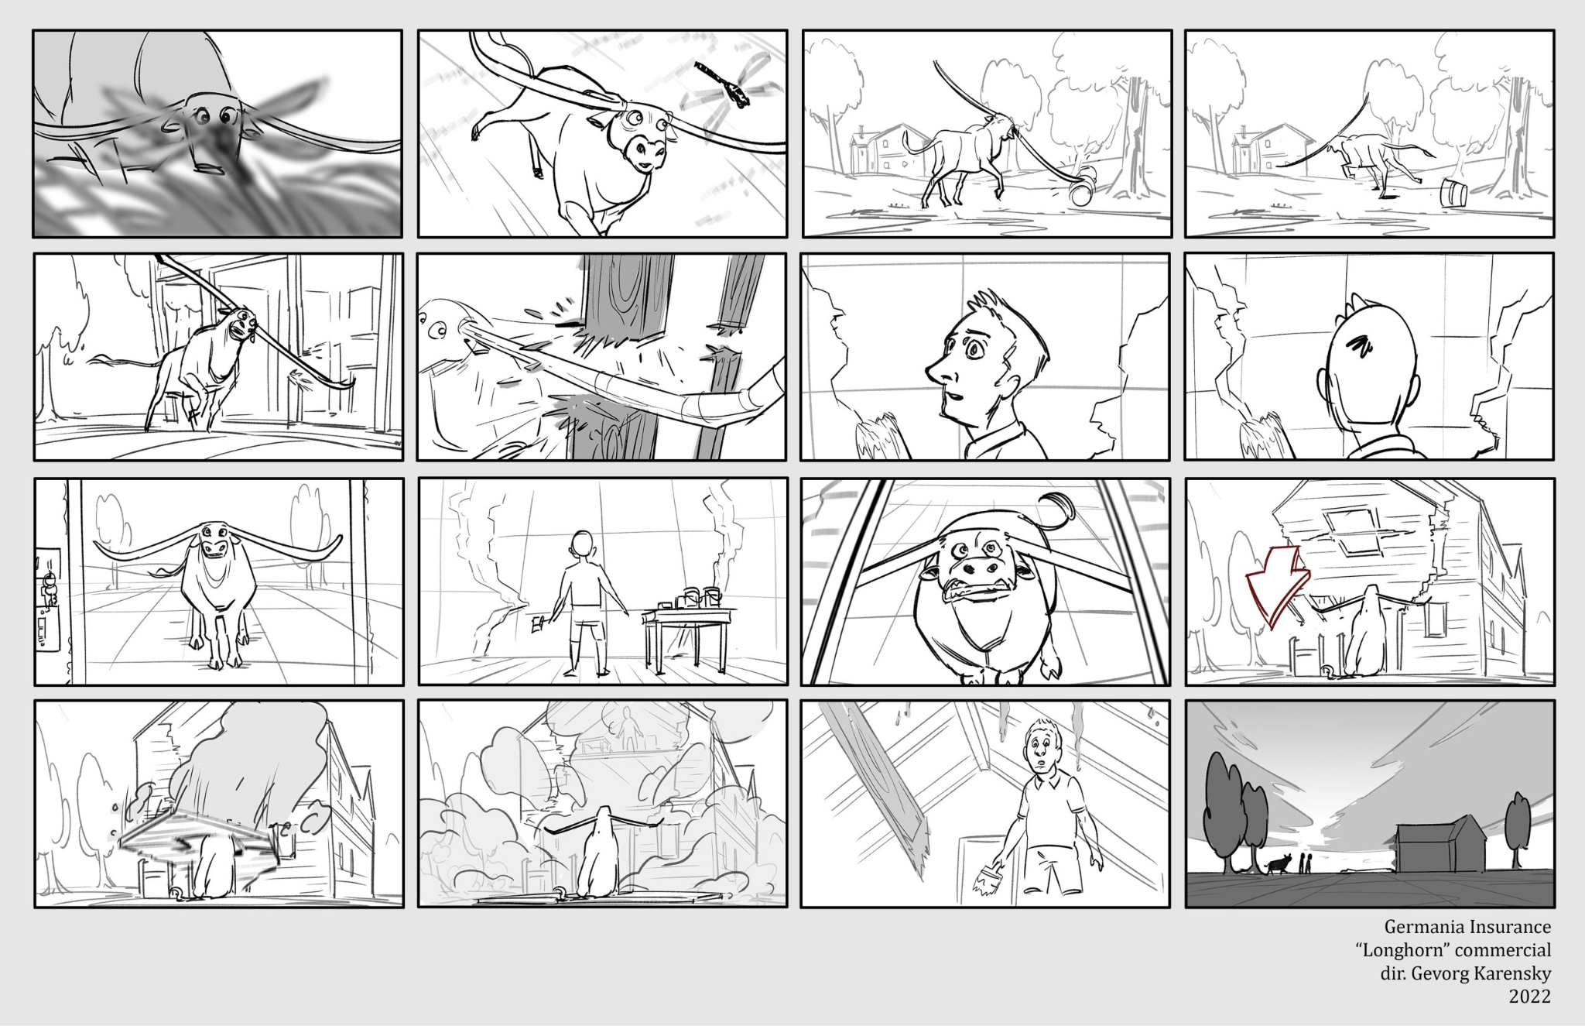
Optional Extension Activities
Finished Ahead of Schedule?
Take your project to the next production step. These foundational assets are NOT required but highly encouraged for an advanced MTA
Storyboards: Outline your shot compositions.
Voice Over: Record your dynamic scratch audio track.
Shot Planning: Plan precise motion and staging.
Music Selection: Select a background audio style.
MEET THE ARTIST // CREATIVE EXPLORATION

Slide 14
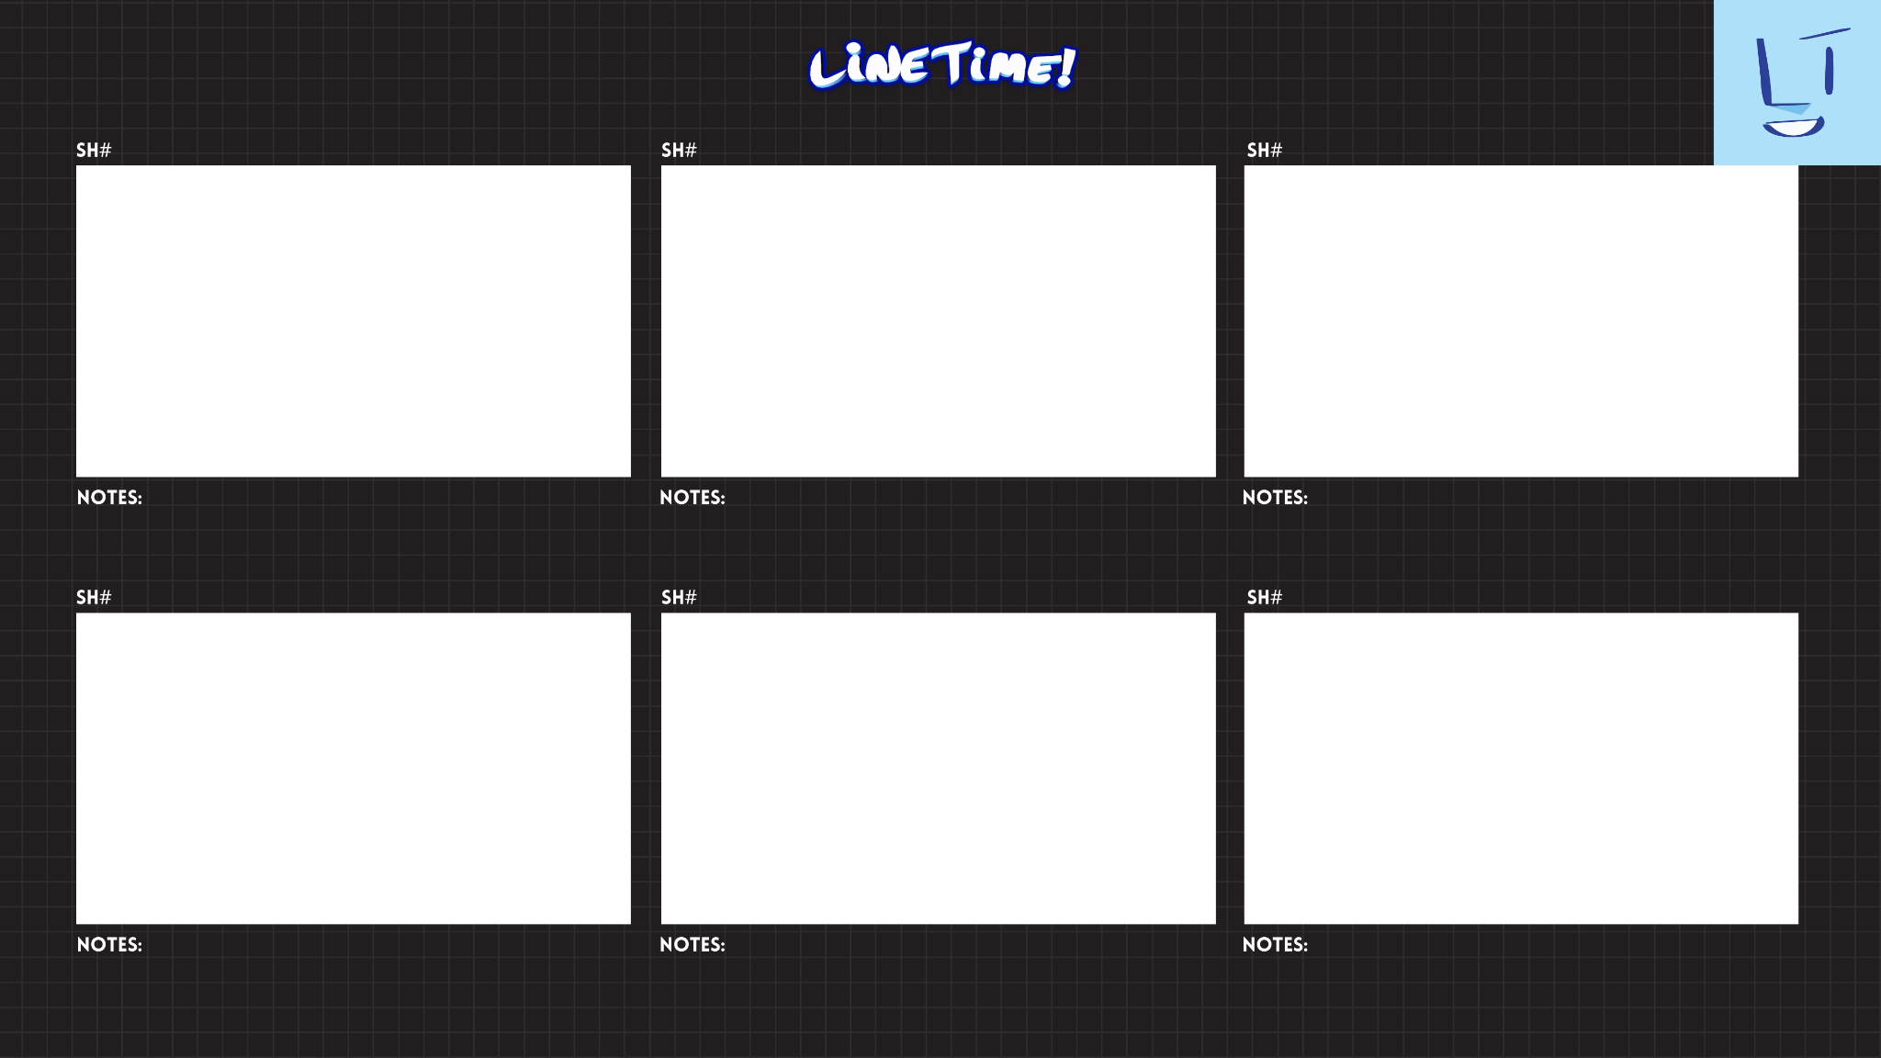

Slide 15



Final Deliverable Checklist or MTA Summer Assignment
Phase 1: Discovery
Phase 2: Concept
Phase 3: Assets
Myers Briggs Personality Test
Unified Mood Board
1 Finalized Asset 3840 × 2160 px
MTA Worksheet
Final Style Frame: 3840 × 2160 px
Optional: Story boards and beyond
MEET THE ARTIST // CREATIVE EXPLORATION

Slide 16
SYMBOLIC SELF-PORTRAIT
What is a Symbolic Self-Portrait?
Instead of just painting/drawing what you see in a mirror, a symbolic self-portrait tells a story about who you are on the inside. It moves past a perfect physical likeness to focus on your thoughts, identity, and experiences.
Here are some key concepts to think about for your assignment:
Symbols Over Realism: You don't need a photo-perfect drawing to tell your story. Instead, you create a "visual language" using everyday items, animals, colors, and settings to represent abstract ideas.
Showing Your Inner World: These portraits are all about looking inward. Use your artwork to give the viewer a glimpse into your personality, your daily struggles, your cultural roots, or your future goals.
Personal Yet Universal: While the story is yours, the feelings are human. By sharing your specific experiences with things like moving to a new school, overcoming an obstacle, or finding joy, your audience will connect with their own versions of those feelings.
Concept is King: The final artwork is a reflection of your ideas, not just your face. You have complete creative freedom here—your portrait can be realistic, completely abstract, surreal (dream-like), or a mix of styles.

Slide 17
PROJECT:SYMBOLIC SELF-PORTRAIT
DIRECTIONS:
Use your previously developed moodboard to develop thumbnails for your Symbolic self-portrait. All stages of the assignment must be completed in order for the final assignment to be evaluated.
ASSIGNMENT04: THUMBNAILS
Develop 10-15 thumbnail drawings with different compositions, subject matter, artistic influence, canvas orientation along different art media (Traditional/Digital). Photograph/upload thumbnails and submit into assignment.
ASSIGNMENT05: ROUGH DRAFT
Begin to enlarge your most successful thumbnail digitally or traditionally based on research. Develop the rough until the image demonstrates a strong composition, art history influence, and technique. Photograph/upload ROUGH DRAFT and submit into assignment.
ASSIGNMENT06: FINAL DRAFT
Based on your enlarged rough drawing, begin to finalize the work by focusing on the following criteria:
•Composition
•Art history influence
•Use of Symbols
•Application of Media (Traditional, Digital, Tradigital, etc.)
•Photograph/upload FINAL DRAFT and submit into assignment.

Slide 18
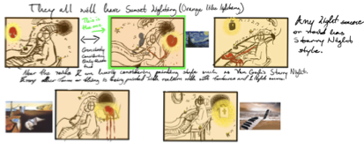
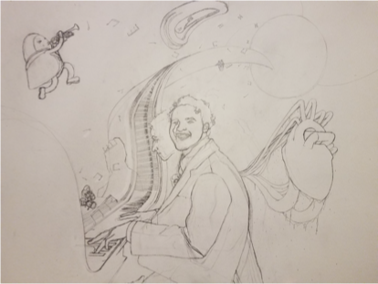
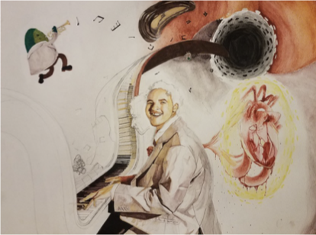
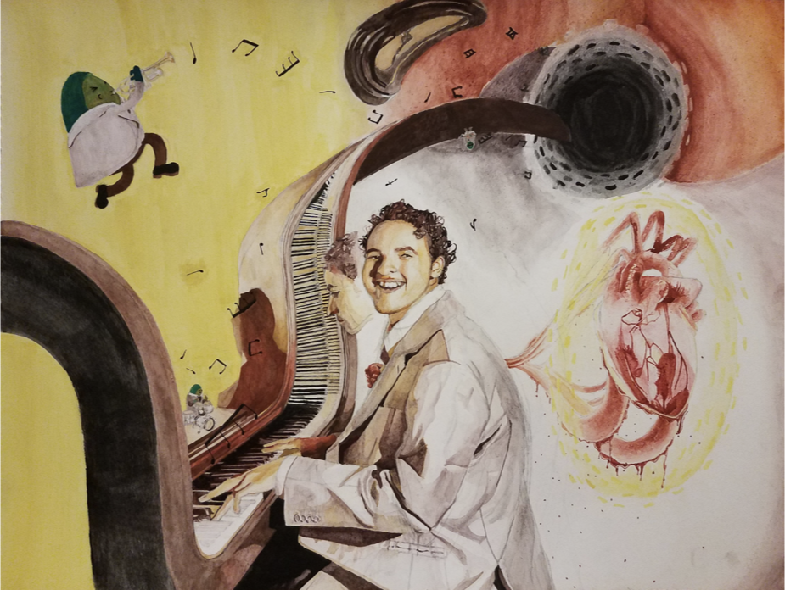
PART01:THUMBNAILS
PART02: ROUGH DRAFT
PART03: FINAL DRAFT

Slide 19
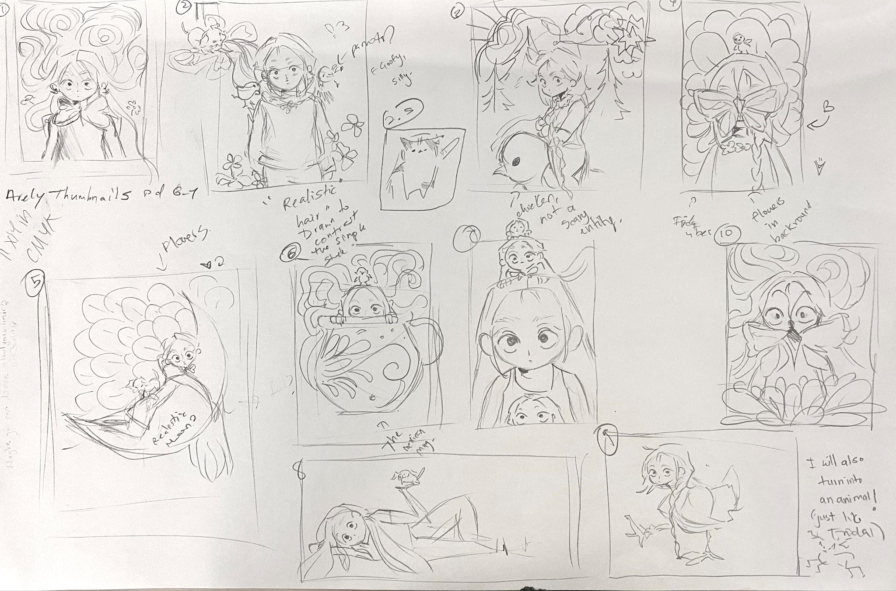
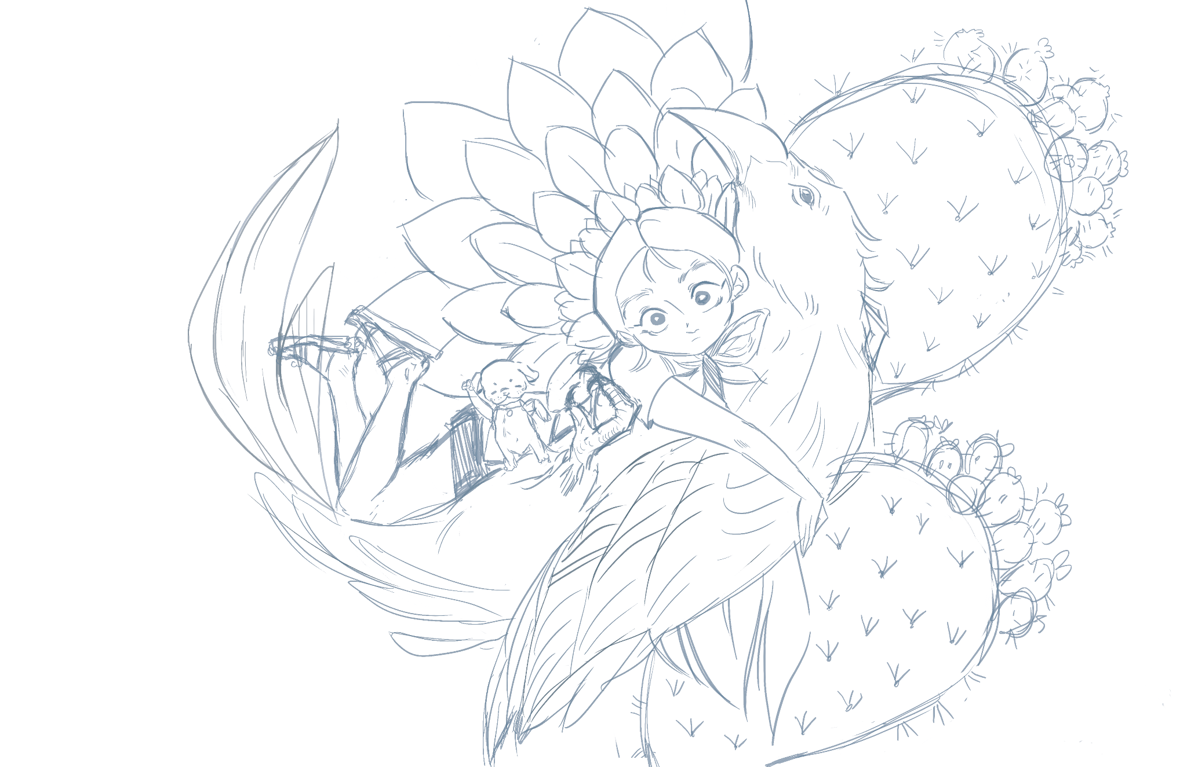
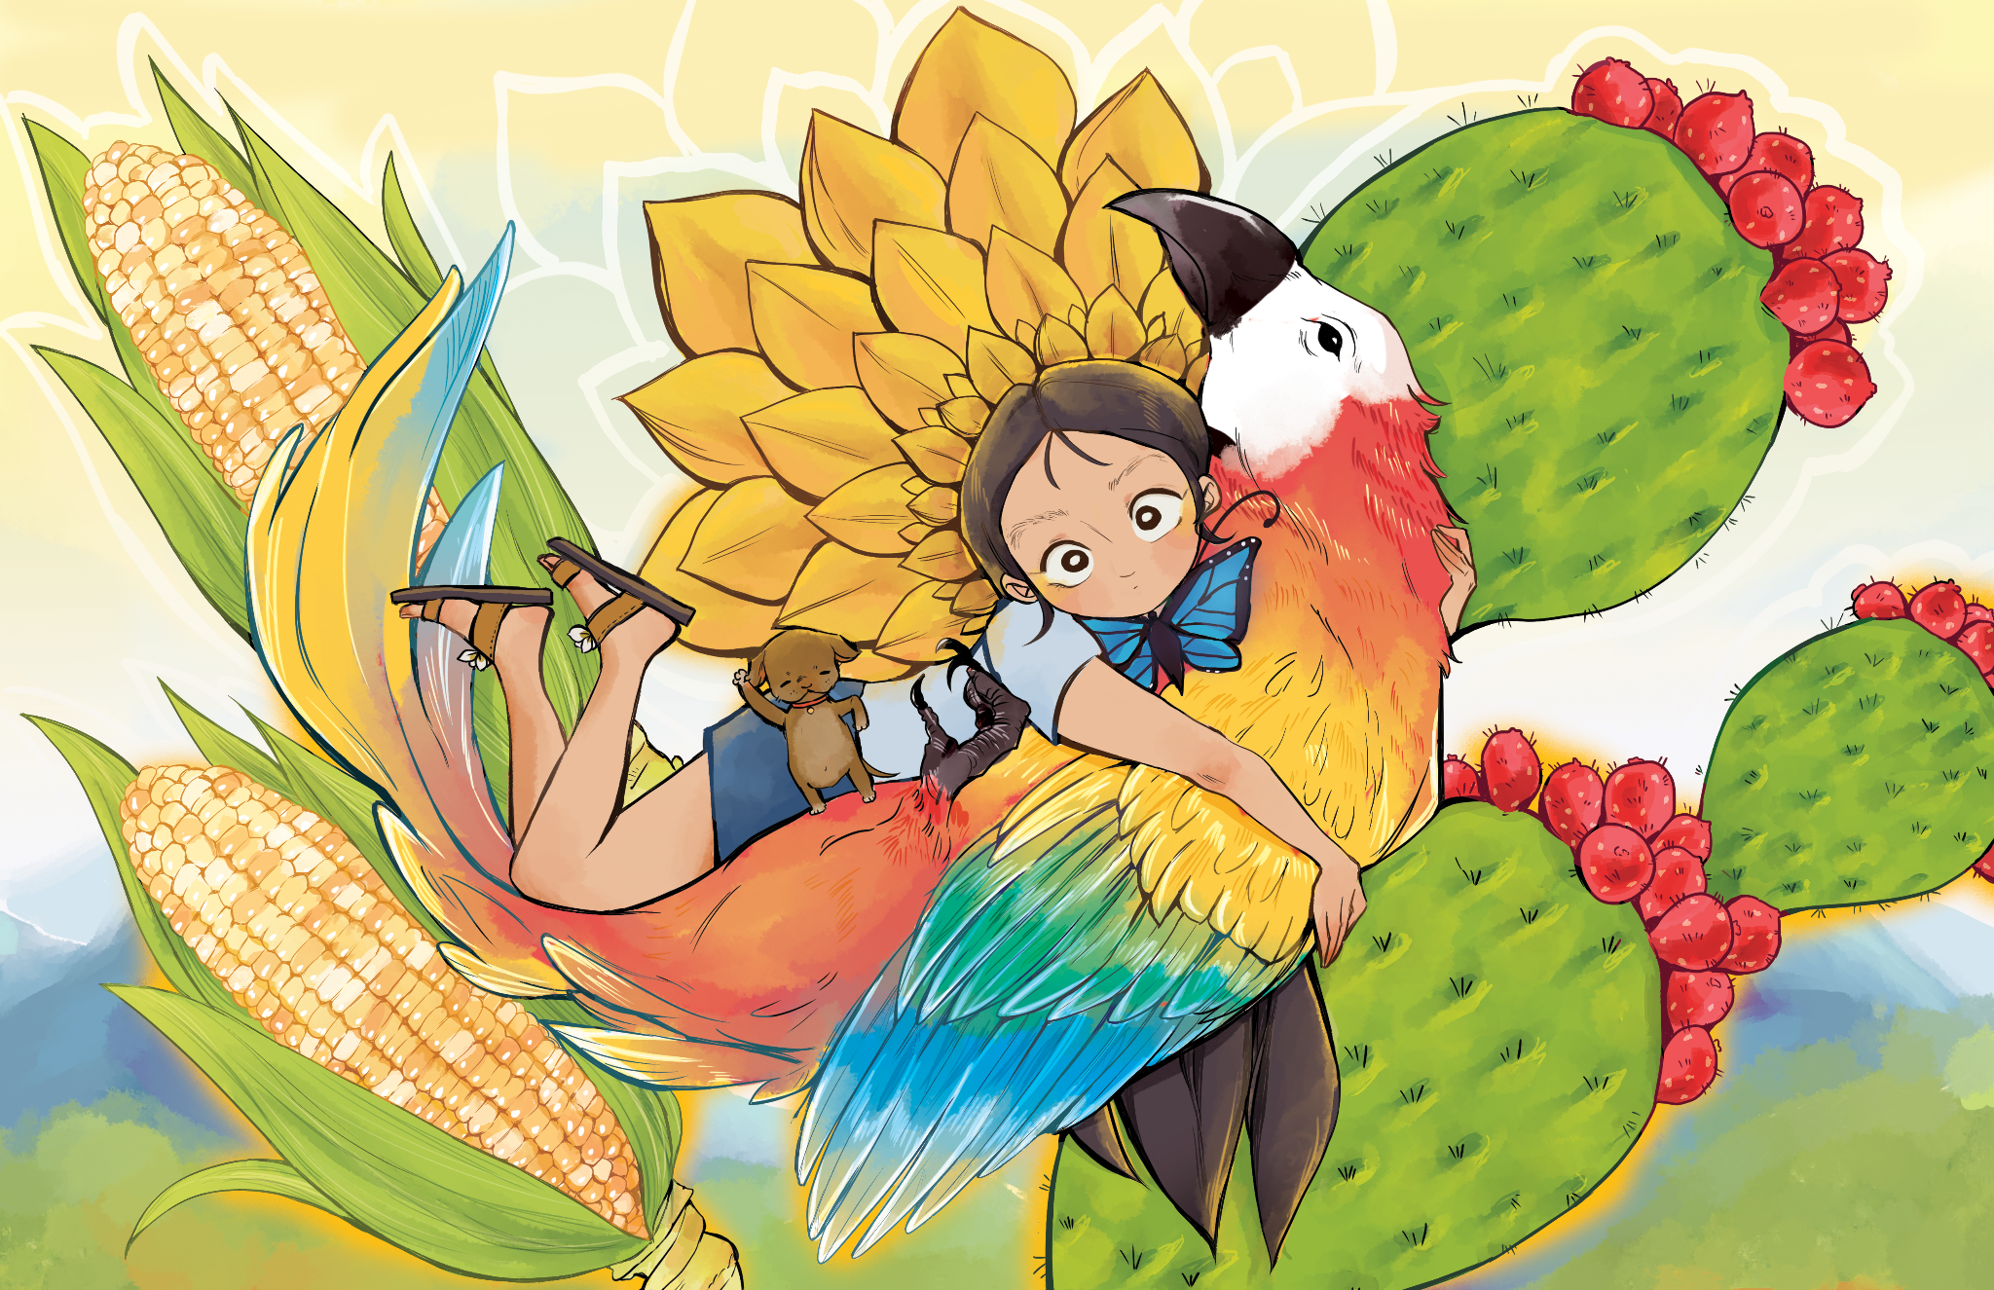
PART01:THUMBNAILS
PART02:ROUGH DRAFT
PART03: FINAL DRAFT

Slide 21
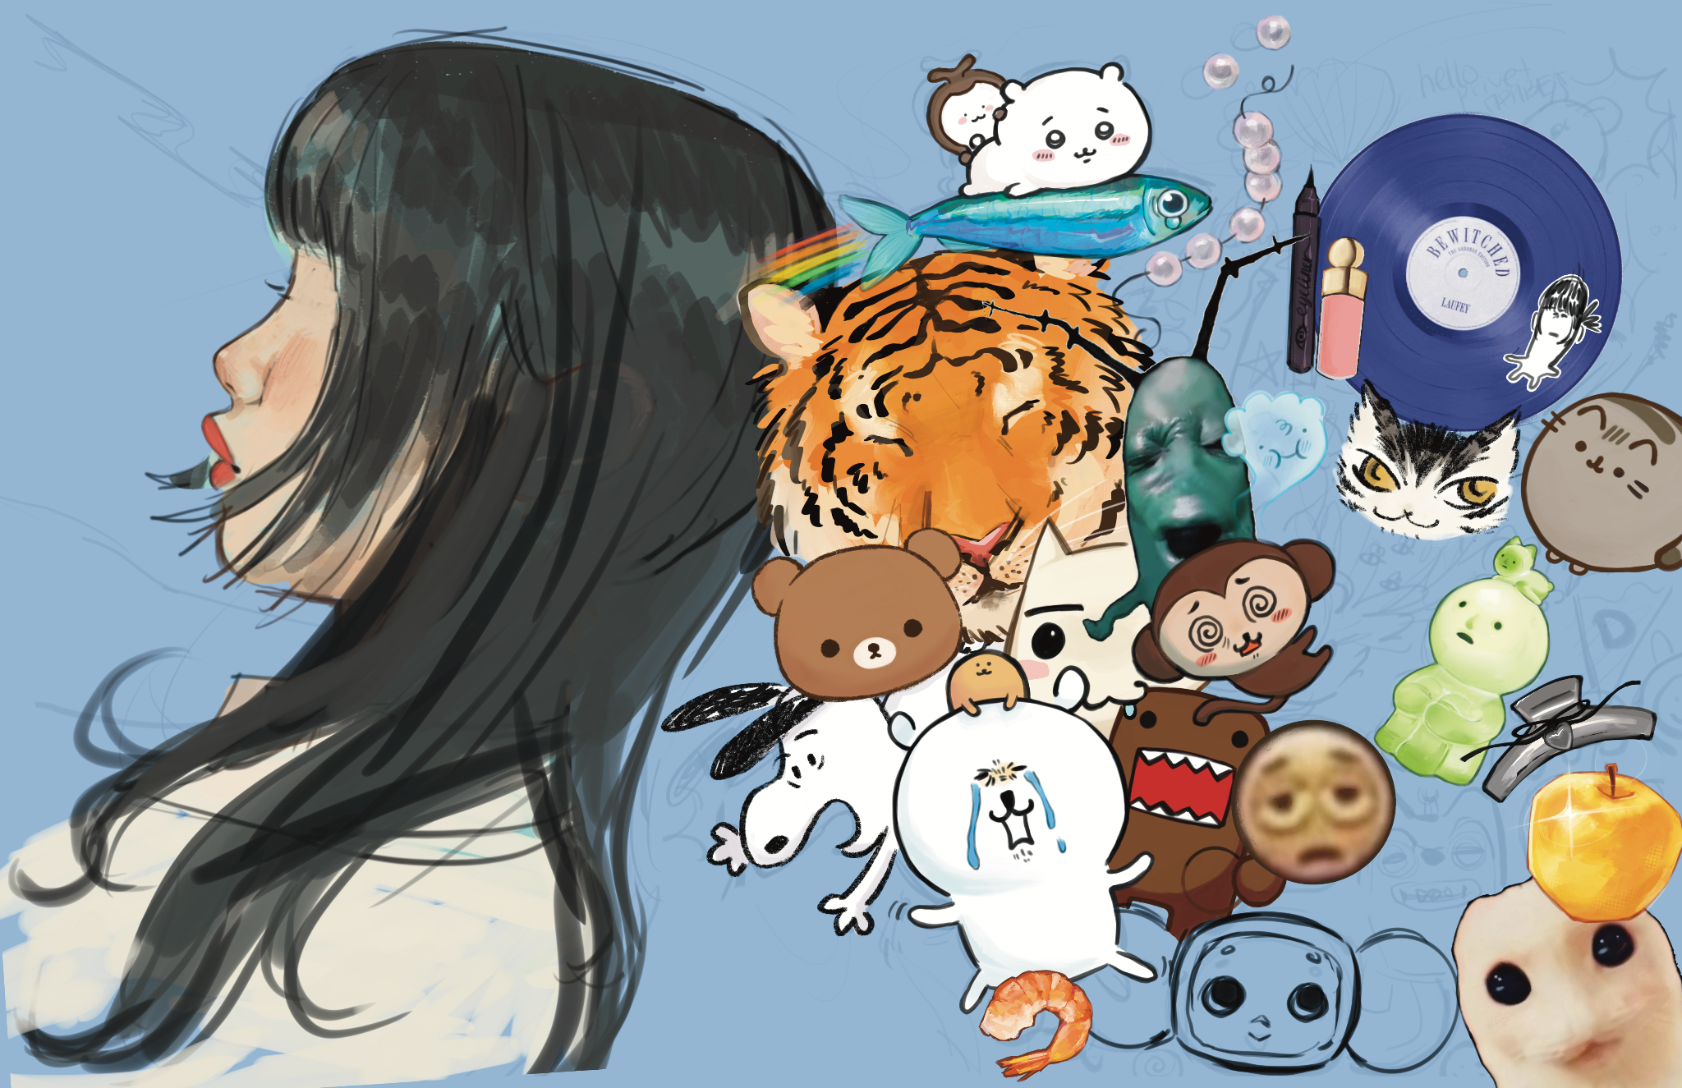

Slide 22
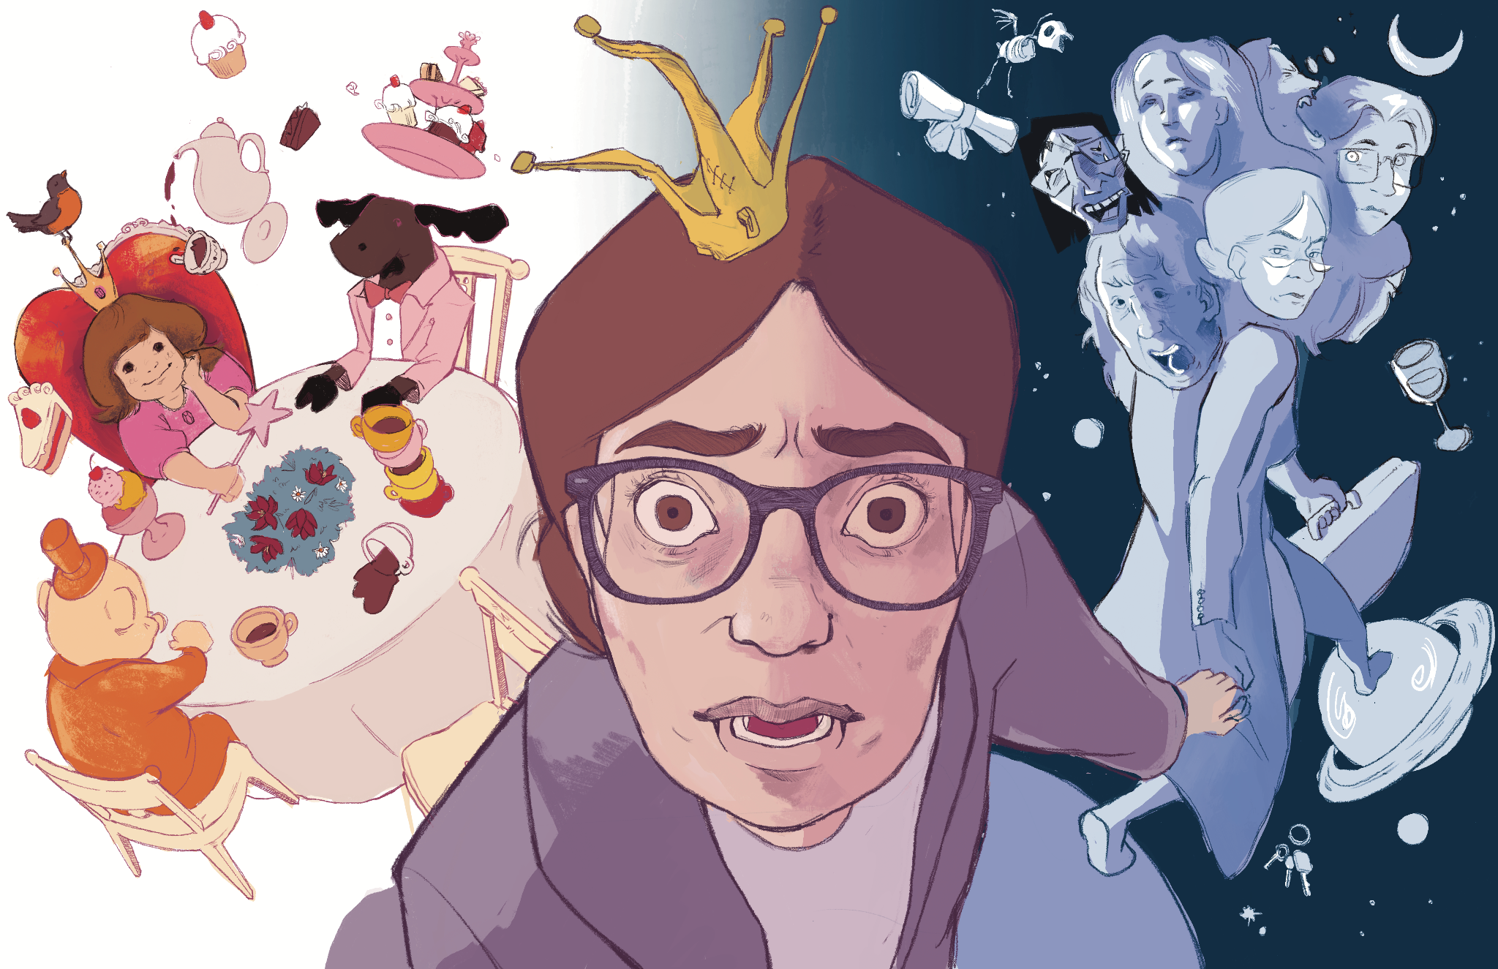

Slide 23
